Slide 1
Public Key Cryptography

Slide 2
Asymmetric Encryption
public-key/two-key/asymmetric cryptography
Is a form of cryptosystem in which encryption and decryption are performed by using diff keys-one a public key and a private key
Transforms plaintext into ciphertext using one of the two keys and an encryption algm . Using the paired key and decryption algm , the plaintext is recovered from the ciphertext

Slide 3
involves the use of two keys:
  a public-key, which may be known by anybody, and can be used to encrypt messages, and verify signatures
  a private-key, known only to the recipient, used to decrypt messages, and sign (create) signatures
is asymmetric because
  those who encrypt messages or verify signatures cannot decrypt message or create signatures
Infeasible to determine the decryption key ,by knowing only about cryptographic algm and encryption key
Commonly used public key algm-RSA

Slide 4
System has following parts:
Plaintext : Original msg given as i/p to algm
Encryption algm : Performs various transformation on plaintext
Public and Private key: Pair of key , one used for encryption and other for decryption
Exact transformation depend on the public or private key that is provided as i/p
Ciphertext : Scrambled msg produced as o/p . Depends on the plaintext and the key.Two diff key will produce 2 diff o/p
Decryption Algm : Accepts ciphertext and the matching key and produce the original plaintext

Slide 5

Encryption

Slide 6
Steps:
1.Each user generates a pair of key to be used for encryption and decryption
2.Each user places one key in a public register. This is the public key . The companion key is private
3.In the above fig Bob maintains a collection of public keys obtained from other
4.If Bob wishes to send a confidential msg to Alice,Bob encrypts the msg using Alice public key
5.When Alice receives the msg,she decrypts that using her private key. No others can decrypt the msg bcz only Alice knows her private key

Slide 7
All participants have access to public keys but private keys are local to that particular participant and need not be distributed

Slide 8
Secrecy
X^
  PR_{b}^
Source A Destination B
Xxxxxxx x Y x
PU_{b} PR_{b}
Cryptanalyst
MMsg Source
Encryption Algm
Decryption Algm
Destination
sKey Pair Source

Slide 9
Here X is the plaintext PU_{b} is the public key.
Y->ciphertext
PR_{b} ->private key, known only to B
PU_{b} is the publicly available and therefore accessible by A
Y=E(PU_{b},X)
X=D(PR_{b},Y)
The cryptanalyst try to recover X by generating X^ or PR_{b}
The above fig provides confidentiality or secrecy

Slide 10
Authentication
  PRa ^
Source A Destination B
X Y X
PRa PU_{a}
Cryptanalyst
MSGMsg Source
Encryption Algm
Decryption Algm
Destination
sKey Pair Source

Slide 11
Y=E(PR_{a}, X)
X=D(PU_{a}, Y)
Here A send a msg to B and encrypts using A’s private key before transmitting it
B can decrypt the msg using A’s public key
Since the msg is encrypted using A’s private key,it ensures that only A prepares the msg
It is impossible to alter the msg without access to A’s private key.So msg is authentic

Slide 12

Secrecy And Authentication

Slide 13
Z=E(PU_{b}, E(PR_{a}, X))
X= D(Pu_{a},D(PR_{b},Z))
Here first we encrypt the msg using senders private key this provides digital signature
Next we again encrypt using the receivers public key
Final ciphertext can be decrypted only by intended receivers, who alone has the matching private key. Thus confidentiality is provided
Disadv : Complex than symmetric key algm

Slide 14
Applications
1.For encryption and decryption using key pairs
2.Digital Signature : The sender signs a msg with its private key. Signing is done using cryptographic algm applied to the msg or to a small block of data
3.Key exchange:Two sides coperate to exchange a session key

Slide 15
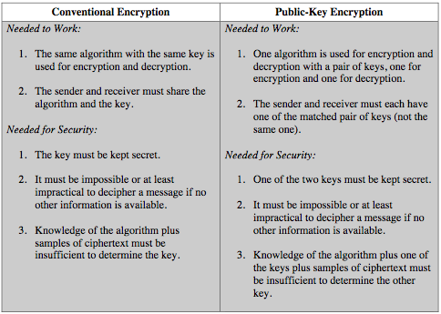

Slide 16
RSA Algorithm
by Rivest, Shamir & Adleman of MIT in 1977
an algorithm for public-key encryption
Block cipher in which plaintext and ciphertext are integers between 0 and n-1 for some n
encryption key is public and differs from the decryption key which is kept secret
Security relies on the difficulty of factoring large composite numbers

Slide 17
A user of RSA creates and then publishes the product of two large prime numbers, along with an auxiliary value, as their public key
The prime factors must be kept secret
Anyone can use the public key to encrypt a message,
Only someone with knowledge of the prime factors can feasibly decode the message
it is hard to factorize large numbers

Slide 18
RSA Key Generation
Each user generates a public/private key pair
Selecting two large primes at random : p, q
computing their system modulus N=p.q
  ø(N)=(p-1)(q-1)
selecting at random the encryption key e
    where 1<e<ø(N), gcd(e,ø(N))=1
To find decryption key d
  e.d=1 mod ø(N) and 0≤d≤N
  d=e⁻¹ mod Ф(n)
publish their public encryption key: KU={e,N}
keep secret private decryption key: KR={d,p,q}

Slide 19
Encryption & Decryption
To encrypt a message M the sender:
  obtains public key of recipient KU={e,N}
  computes: C=Me mod N, where 0≤M<N
To decrypt the ciphertext C the owner:
  uses their private key KR={d,p,q}
  computes: M=C^{d} mod N
note that the message M must be smaller than the modulus N (block if needed)

Slide 20
M represents the plaintext block and C represents ciphertext block
Then C=Me mod N
M=C^{d} mod N
=M^{ed} mod N
Value of ‘n’ knows to both sender and receiver
‘e’ knows only to the sender
‘d’ knows only to the receiver
Public key,KU={e,n}
Private key,KR={d,n}

Slide 21
Following requirements must be met for a satisfactory algm:
1.It is possible to find the values of e,d,n such that M^{ed}=M mod N for all M<N
2.It is easy to calculate M^{e and} C^{d} for all values of M<n
3.It is infeasible to determine’d’ given e and n
M^{ed}=M mod N (1)

Slide 22
From this eqt , we have to find the values of e,d and n.To find this,we use corollary to Euler’s theorem
m^kФ(n)+1=[(M ^{Ф(n)})^{k} *M]mod n
=[(1)^{k}*M] mod n by Eulers theorem
=M mod n ->(2)
By comparing eqt 1 & 2
ed=k Ф(n)+1
ed=1mod Ф(n)
d=e⁻¹ mod Ф(n)
e and are multiplicative inverse of mod Ф(n)

Slide 23
RSA Example
Select primes: p=17 & q=11
Compute n = pq =17×11=187
Compute ø(n)=(p–1)(q-1)=16×10=160
Select e : gcd(e,160)=1; choose e=7
Determine d: de=1 mod 160 and d < 160 Value is d=23
Publish public key KU={7,187}
Keep secret private key KR={23,17,11}

Slide 24
sample RSA encryption/decryption is:
given message M = 88 (nb. 88<187)
encryption:
  C = 88⁷ mod 187 = 11
decryption:
  M = 11²³ mod 187 = 88

Slide 25
Encryption
Decryption
Ciphertext
Plaintext
11
Plaintext
88
7
mod
187
=
11
11
23
mod
187
=
88
88
88
KU
=
7
,
187
KR
=
23
,
187
Figure
1
.
Example of RSA Algorithm

Slide 26
RSA Security
three approaches to attacking RSA:
  brute force key search (infeasible given size of numbers)
  mathematical attacks based on difficulty of computing ø(n), by factoring modulus n
  timing attacks - on running of decryption
  chosen ciphertext attacks - given properties of RSA

Slide 27
Factoring Problem
mathematical approach takes 3 forms:
  factor N=p.q, hence find ø(N) and then d
  determine ø(N) directly and find d
  find d directly
currently believe all equivalent to factoring
  have seen slow improvements over the years
    as of Aug-99 best is 130 decimal digits (512) bit with GNFS
  biggest improvement comes from improved algorithm
    cf “Quadratic Sieve” to “Generalized Number Field Sieve”
  barring dramatic breakthrough 1024+ bit RSA secure
    ensure p, q of similar size and matching other constraints

Slide 28
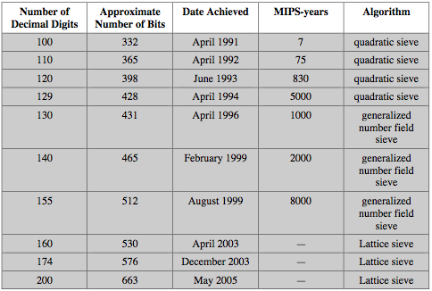
Progress in Factoring

Slide 29
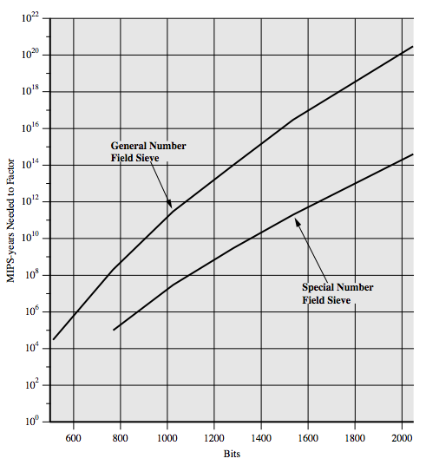
Progress in Factoring

Slide 30
Timing Attacks
developed in mid-1990’s
exploit timing variations in operations
  eg. multiplying by small vs large number
  or IF's varying which instructions executed
infer operand size based on time taken
RSA exploits time taken in exponentiation
countermeasures
  use constant exponentiation time
  add random delays
  blind values used in calculations

Slide 31
Chosen Ciphertext Attacks
RSA is vulnerable to a Chosen Ciphertext Attack (CCA)
attackers chooses ciphertexts & gets decrypted plaintext back
choose ciphertext to exploit properties of RSA to provide info to help cryptanalysis
can counter with random pad of plaintext
or use Optimal Asymmetric Encryption Padding (OASP)

Slide 32
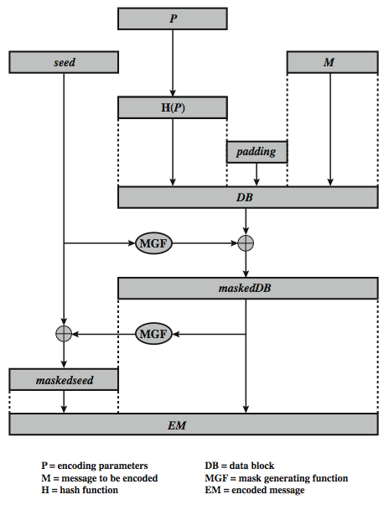
Optimal Asymmetric Encryption Padding (OASP)

